Slide 1

POORNIMA INSTITUTE OF ENGINEERING & TECHNOLOGY DEPARTMENT OF COMPUTER ENGINEERING PROJECT PRESENTATION ON AI Virtual Mouse
SESSION 2021-22
Presented By: Byte Crunchers Guided By: Mr. Deepak Moud
Team member: 1. Rahul Chhablani (PIET18CS114) Designation: HOD, CSE Dept.
2. Sagar Gyanchandani (PIET18CS127) May, 2022
3. Yash Koolwal (PIET18CS153)

Slide 2
INTRODUCTION
This project presents an AI virtual mouse system that uses computer vision to perform mouse activities in the computer utilising hand motions and hand tip recognition.
The AI virtual mouse system was created using the Python programming language, as well as OpenCV, a computer vision library.
The proposed AI virtual mouse system makes use of the MediaPipe package for tracking the hands and the tip of the hands, as well as the Pynput, Autopy, and PyAutoGUI packages for moving around the computer's window screen and performing functions like left click, right click, and scrolling functions.
The proposed model's results demonstrated a very high level of accuracy, and the proposed model can function extremely well in real-world applications using only a CPU and no GPU.

Slide 3
PROJECT AIM AND OBJECTIVE
The suggested AI virtual mouse technology can be used to solve problems in the real world, such as instances where there isn't enough space to use a physical mouse or for people with hand problems who can't use a physical mouse.
Furthermore, in the COVID-19 situation, it is not safe to use devices by touching them because this could result in the virus spreading, so the proposed AI virtual mouse can be used to overcome these issues.
The suggested AI virtual mouse system's main goal is to create an alternative to the regular and traditional mouse system for performing and controlling mouse functions. This can be accomplished using a web camera that captures hand gestures and hand tips.

Slide 4
PROBLEM STATEMENT AND REQUIREMENTS
The computer can be controlled virtually using hand gestures and can perform left click, right click, drag and drop, and volume control functions without the use of a physical mouse. For detecting the hands, the algorithm uses deep learning. As a result, the proposed system will prevent COVID-19 from spreading by removing the need for human intervention and device control.
Software Requirements: VsCode, OpenCV Python, Pycharm
Hardware Requirements: PC and Webcam

Slide 5
TECHNOLOGIES APPLIED IN PROJECT
Python: Python is a high-level, general-purpose programming language that is interpreted. Its design philosophy emphasises code readability through extensive indentation. Its language components and object-oriented strategy are intended to assist programmers in writing concise, reasonable code for both large and small applications.
OpenCV: OpenCV is a programming library that focuses on real-time computer vision. It's great for computer vision applications like video and CCTV footage analysis, as well as image analysis. We can use this library to focus on real-world problems when developing computer vision applications that we don't want to build from scratch.

Slide 6
AGILE METHODOLOGY
Agile is one form of software development methodology. Its main focus is on client satisfaction through continuous delivery.
The focus of Agile is more on limiting the project scope. An agile project sets a minimum number of requirements and turns them into a deliverable product.
Agile development methodology provides opportunities to assess the direction of a project throughout the development lifecycle. By focusing on the repetition of abbreviated work cycles as well as the functional product they yield, agile methodology is described as “iterative” and “incremental”. In waterfall, development teams only have one chance to get each aspect of a project right.

Slide 7
Various key terms associated with it are as follows-
Scrum: Scrum is a process framework used to manage product development and other knowledge work. Scrum is empirical in that it provides a means for teams to establish a hypothesis of how they think something works, try it out, reflect on the experience, and make the appropriate adjustments. Scrum is structured in a way that allows teams to incorporate practices from other frameworks where they make sense for the team’s context.
Scrum master: The scrum master is the team role responsible for ensuring the team lives agile values and principles and follows the processes and practices that the team agreed they would use.
Product Owner: The product owner is a role on a product development team responsible for managing the product backlog in order to achieve the desired outcome that a product development team seeks to accomplish.

Slide 8
Product Backlog: A product backlog is a list of the new features, changes to existing features, bug fixes, infrastructure changes or other activities that a team may deliver in order to achieve a specific outcome.
Sprint Backlog: A sprint backlog is the subset of product backlog that a team targets to deliver during a sprint in order to accomplish the sprint goal and make progress toward a desired outcome.
User story: In consultation with the customer or product owner, the team divides up the work to be done into functional increments called “user stories.”

Slide 9
Daily Meeting: Each day at the same time, the team meets so as to bring everyone up to date on the information that is vital for coordination: each team members briefly describes any “completed” contributions and any obstacles that stand in their way. Usually, Scrum’s Three Questions are used to structure discussion.
The meeting is normally held in front of the task board.
Burn Down Chart: The team displays, somewhere on a wall of the project room, a large graph relating the quantity of work remaining (on the vertical axis) and the time elapsed since the start of the project (on the horizontal, showing future as well as past).
This constitutes an “information radiator“, provided it is updated regularly. Two variants exist, depending on whether the amount graphed is for the work remaining in the iteration (“sprint burndown”) or more commonly the entire project (“product burndown”).

Slide 10
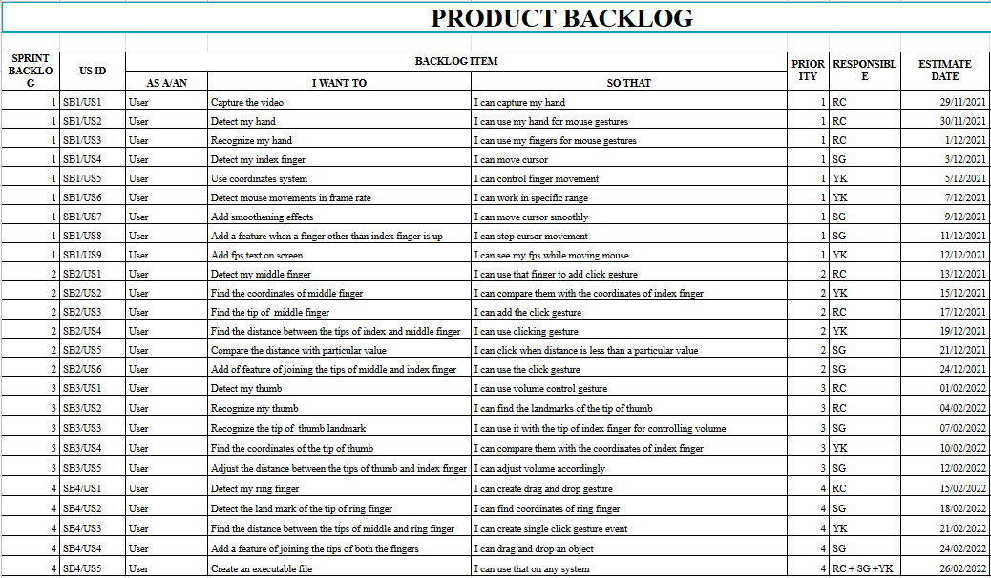
PRODUCT BACKLOG DESIGN
Product Backlog: It consists of a collection of User stories divided into a number of Sprint Backlogs. Our product backlog contains 4 spring backlogs and each of them has different functionality.

Slide 11
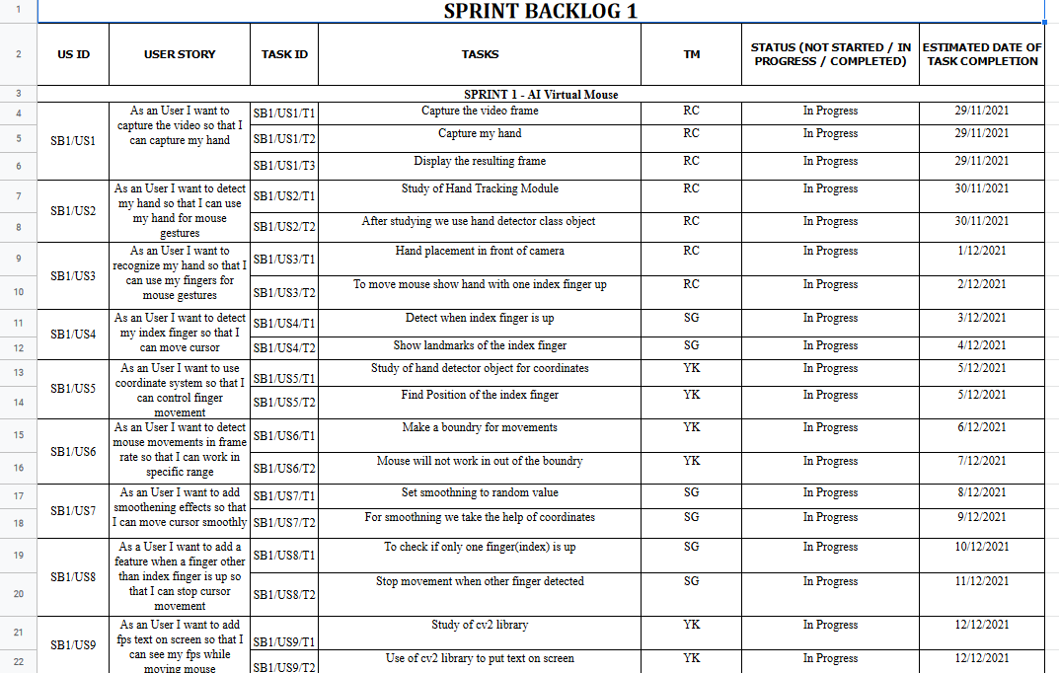
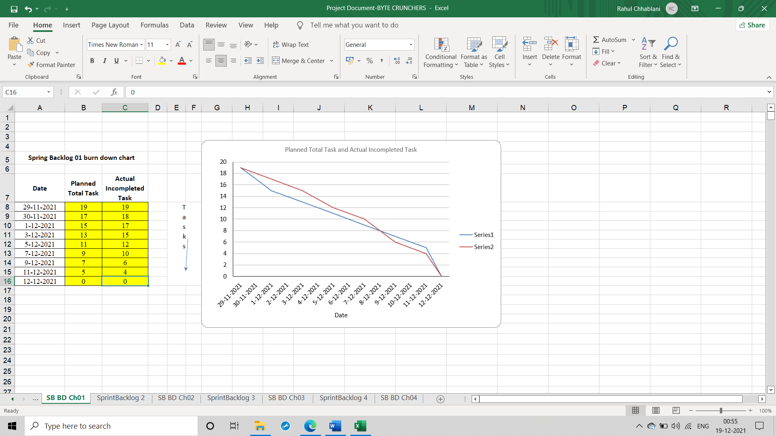
Sprint Backlog-1: It is a collection of User stories and their associated tasks. This spring backlog consists of cursor moving functionality using our index finger.

Slide 12
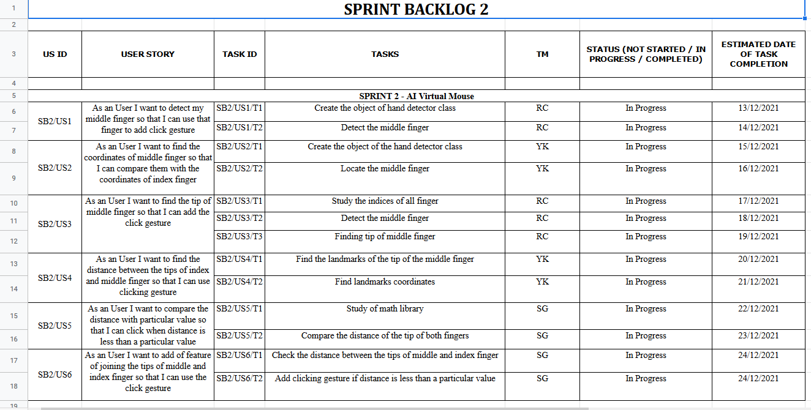
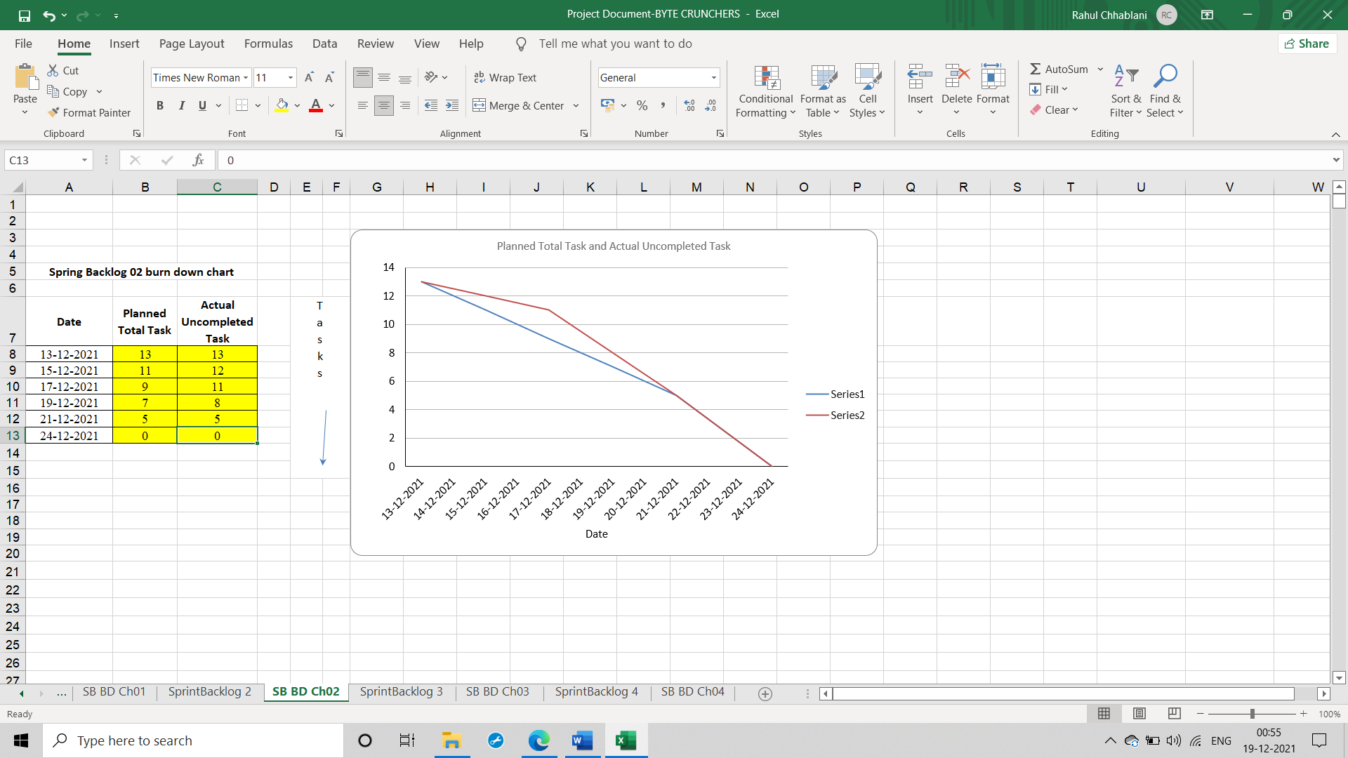
Sprint Backlog-2: This spring backlog consists of clicking functionality using our index finger and middle finger, as we join the tips of our index and middle finger, clicking functionality will be implemented.

Slide 13
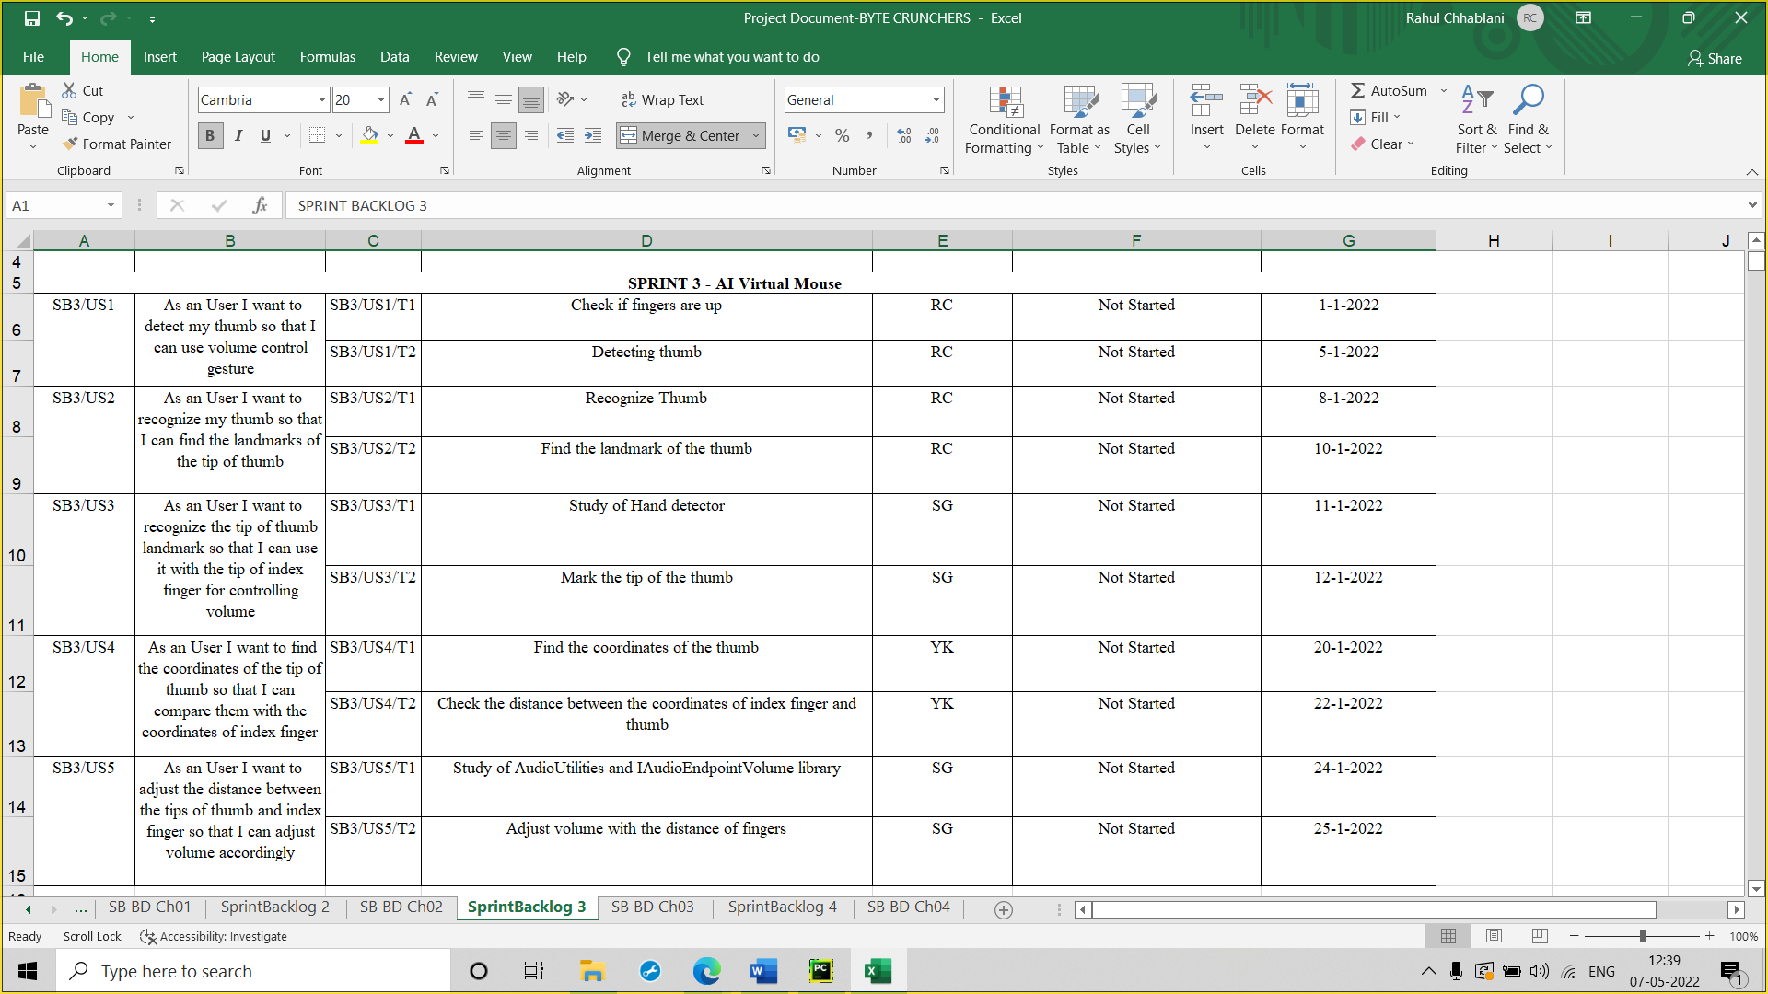
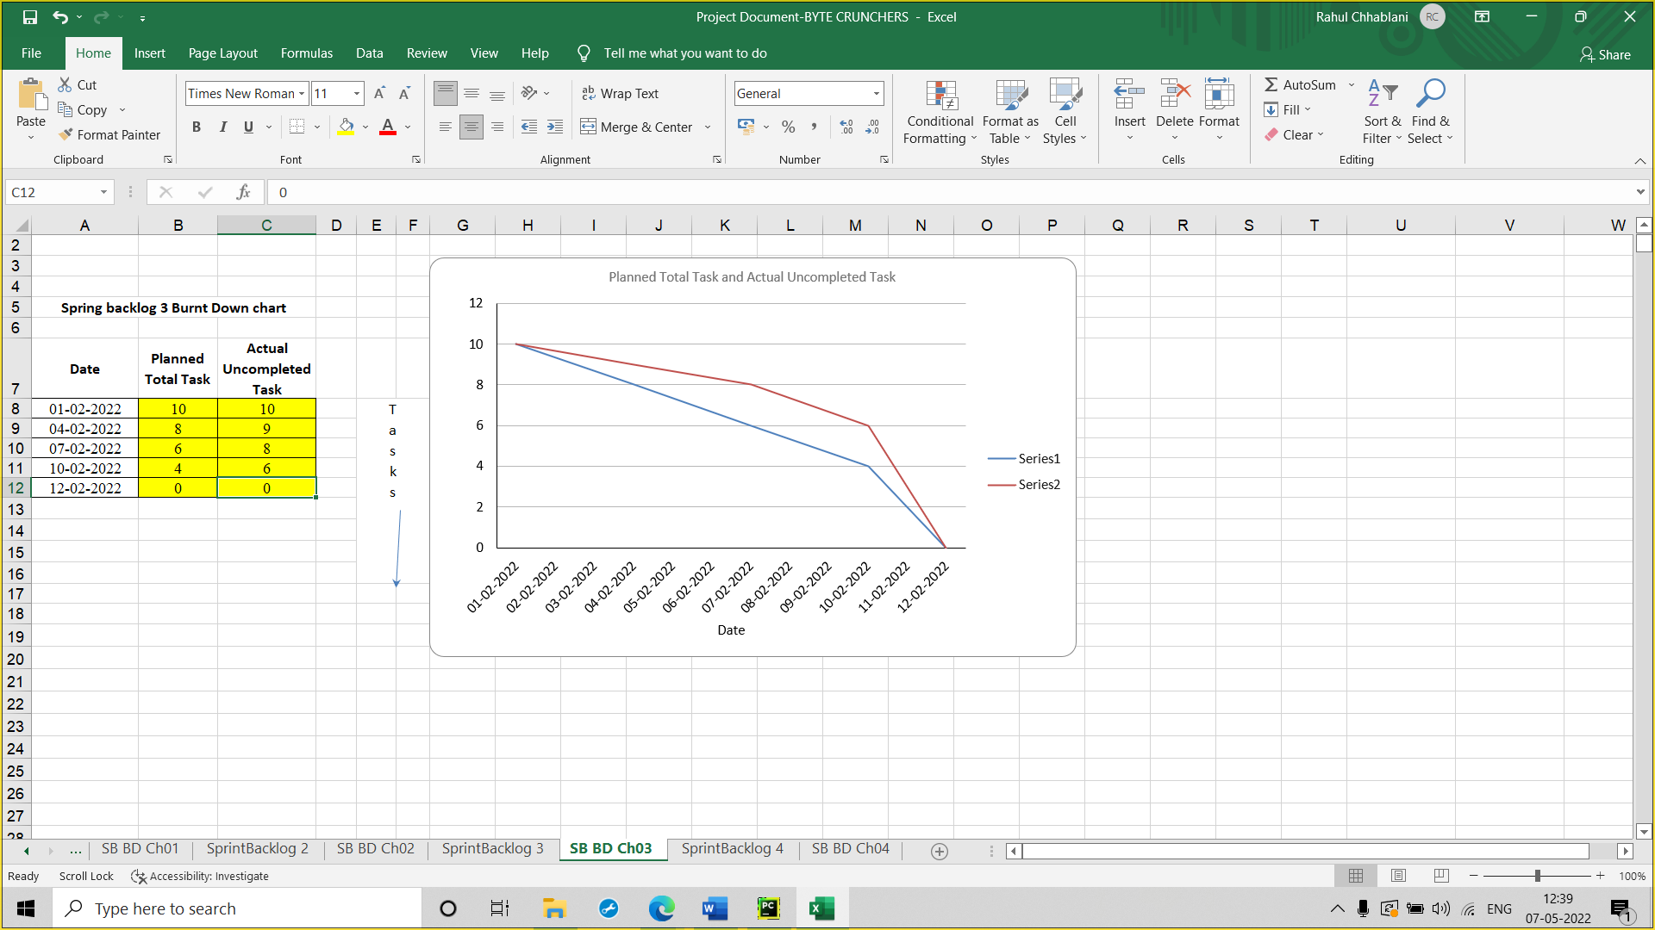
Sprint Backlog-3: This sprint backlog consists of volume control functionality using our index finger and thumb, as we increase the distance between the tips of the fingers, volume increases and volume decreases as we decrease the distance.

Slide 14
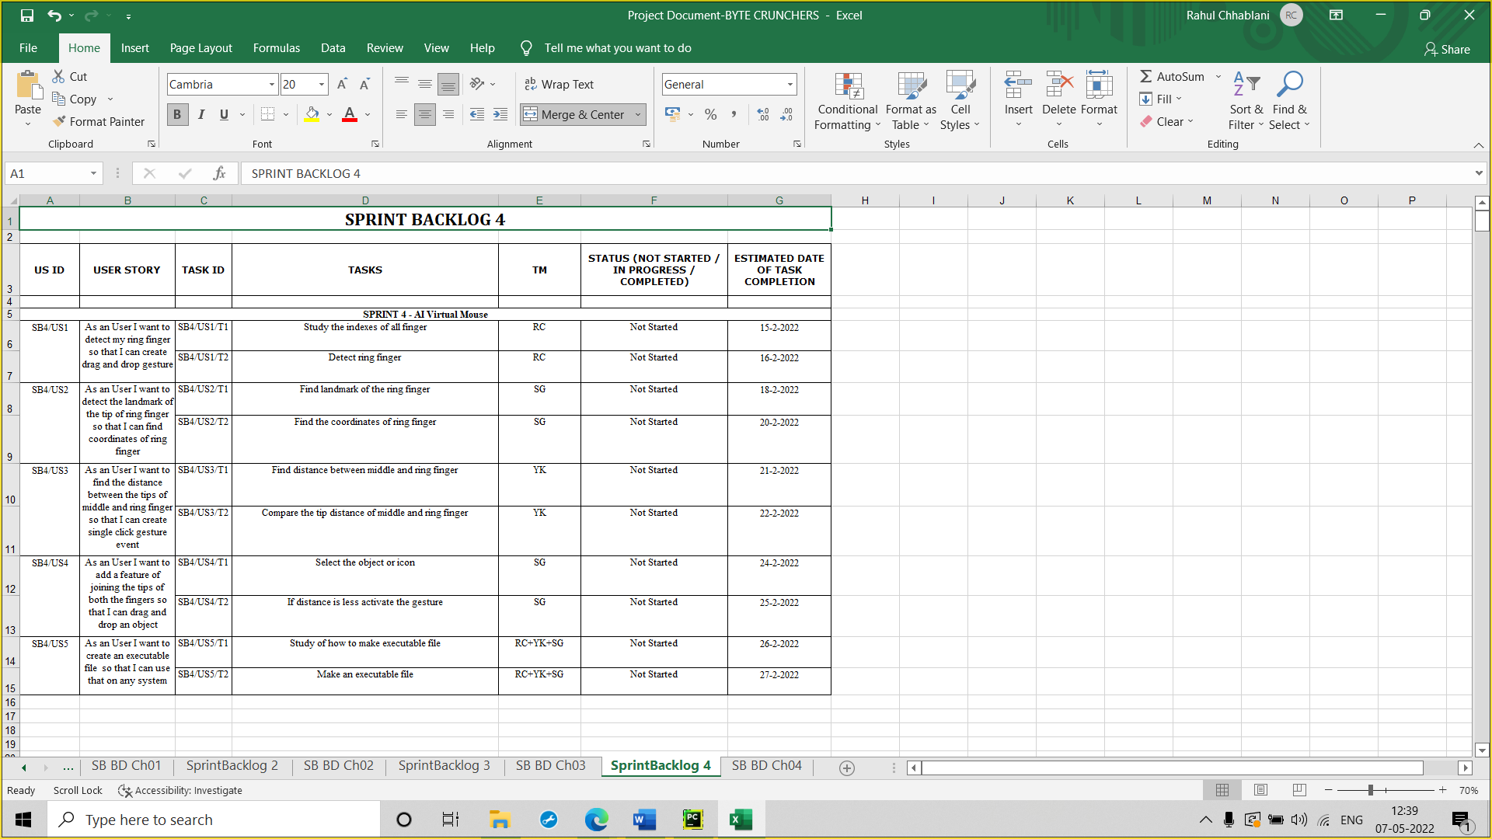
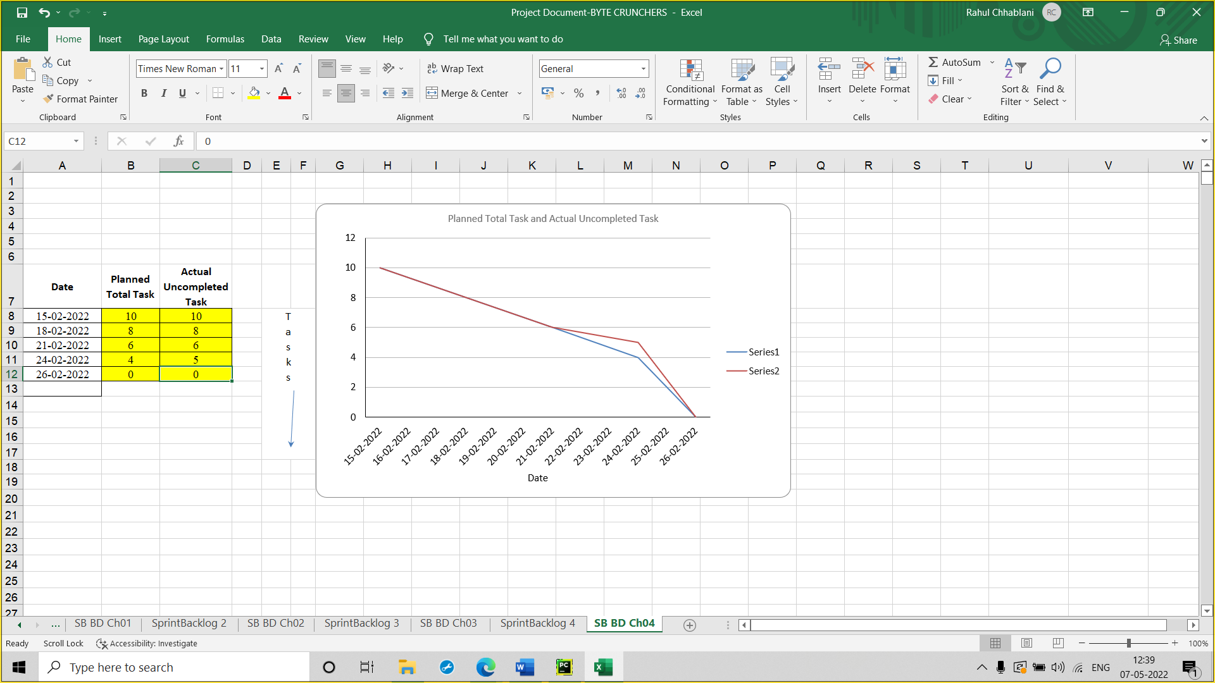
Sprint Backlog-4: This sprint backlog consists of scrolling functionality using our pinky finger and thumb, as we raise our pinky finger, page scrolls down and page scrolls up as we raise our thumb.

Slide 15
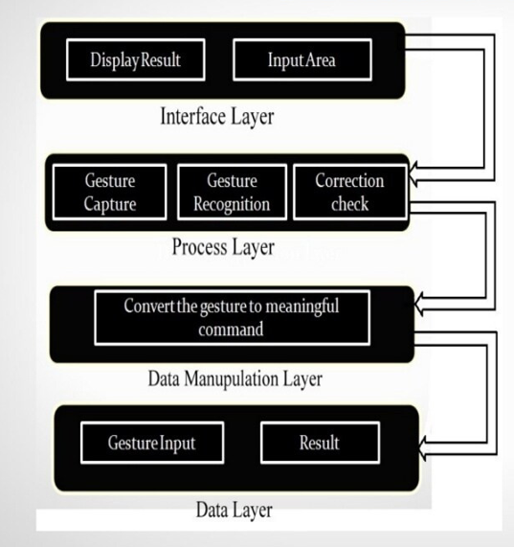
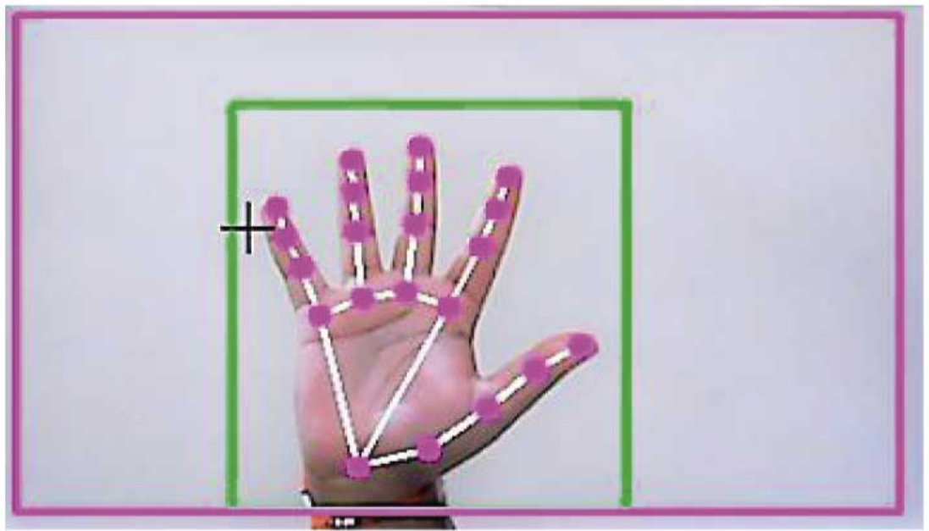
PROJECT IMPLEMENTATION
Architecture:

Slide 16
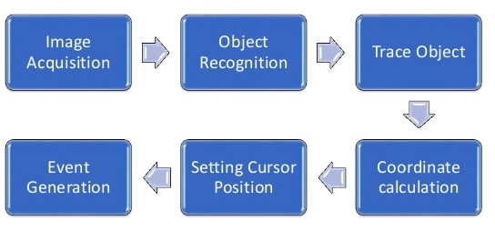
Flow Chart:

Slide 17
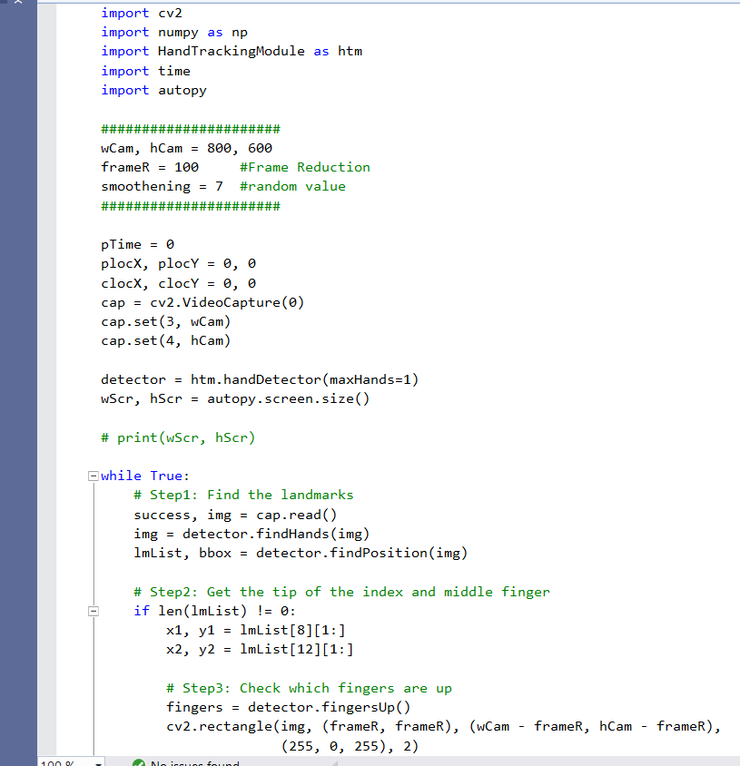
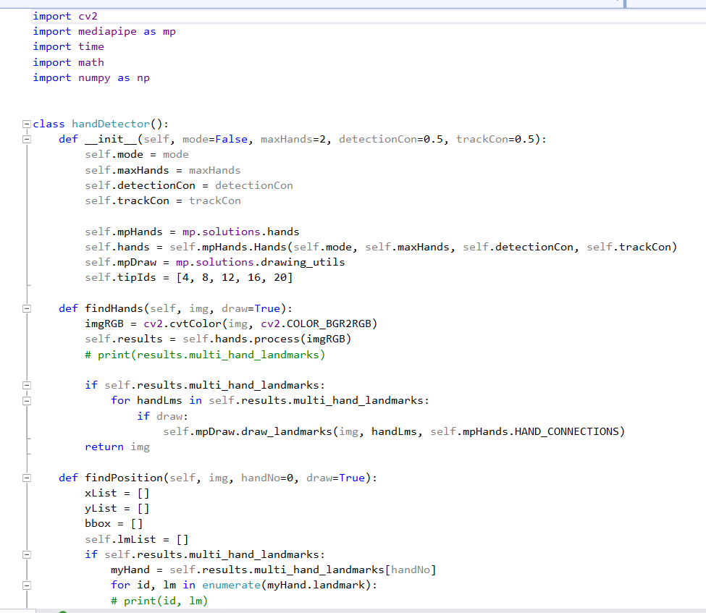
Screenshots:

Slide 18
RESULTS
Conclusion:
We are developing a system to control the mouse using a real-time camera.
This system is based on computer vision algorithms and can do all mouse tasks.
However, it is difficult to get stable results because of the variety of lighting and skin colors of human races.
This system could be useful in presentations and to reduce work space.

Slide 19
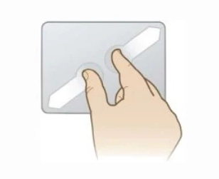
Future Scope:
The proposed AI virtual mouse has some flaws, such as a slight loss of accuracy when using the right click mouse function, and the model has some difficulties selecting text by clicking and dragging. These are some of the drawbacks of the proposed AI virtual mouse system, which will be addressed in future research.
Furthermore, the proposed method can be extended to handle virtual keyboard and mouse functionality, which is another future application of Human-Computer Interaction (HCI).

Slide 20
REFERENCES
https://www.computervision.zone/
https://www.slideshare.net/
https://www.youtube.com/

